Slide 1

Puppet Manifests

Slide 2

Manifests
In Puppet, all the programs which are written using Ruby programming language and saved with an extension of .pp are called manifests.
In general terms, all Puppet programs which are built with an intension of creating or managing any target host machine is called a manifest.
All the programs written in Puppet follow Puppet coding style.

Slide 3
The core of Puppet is the way resources are declared and how these resources are representing their state.
In any manifest, the user can have a collection of different kind of resources which are grouped together using class and definition.

Slide 4
In some cases, Puppet manifest can even have a conditional statement in order to achieve a desired state.
However, ultimately it all comes down to make sure that all the resources are defined and used in the right way and the defined manifest when applied after getting converted to a catalog is capable of performing the task for which it was designed.

Slide 5
Manifest File Workflow
Puppet manifest consists of the following components :
Files (these are plain files where Puppet has nothing to do with them, just to pick them up and place them in the target location)
Resources
Templates (these can be used to construct configuration files on the node).
Nodes (all the definition related to a client node is defined here)
Classes

Slide 6
Key Points
In Puppet, all manifest files use Ruby as their encoding language and get saved with .pp extension.
"Import" statement in many manifest are used for loading files when Puppet starts.
In order to import all files contained in a directory, you can use the import statement in another way like import 'clients/*'. This will import all .pp files inside that directory.

Slide 7
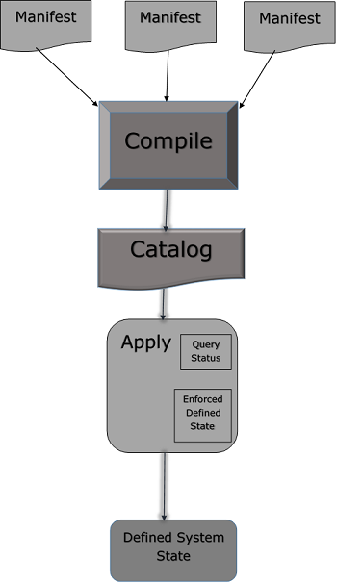

Slide 8
Writing Manifests
Working with Variables
While writing a manifest, the user can define a new variable or use an existing variable at any point in a manifest.
Puppet supports different kind of variables but few of them are frequently used such as strings and array of string. Apart from them, other formats are also supported.
String Variable Example
$package = "vim" package { $package: ensure => "installed" }

Slide 9
Using Loops
Loops are used when one wishes to go through multiple iterations on a same set of code till a defined condition is met.
They are also used to do repetitive tasks with different set of values. Creating 10 tasks for 10 different things.
One can create a single task and use a loop to repeat the task with different packages one wants to install.
Most commonly an array is used to repeat a test with different values.
$packages = ['vim', 'git', 'curl']
package { $packages: ensure => "installed" }

Slide 10
Using Conditionals
Puppet supports most of the conditional structure which can be found in traditional programming languages.
Condition can be used to dynamically define whether to perform a particular task or a set of code should get executed. Like if/else and case statements.
Additionally, conditions like execute will also support attributes that works like condition, but only accepts a command output as a condition.
if $OperatingSystem != 'Linux' { warning('This manifest is not supported on this other OS apart from linux.') } else { notify { 'the OS is Linux. We are good to go!': } }

Slide 11
VIDEO
Notes:
https://www.youtube.com/watch?v=vWqs-z9mCz4
https://www.youtube.com/watch?v=xRju7qCr13I

Slide 12
Puppet Manifest
In puppet, all the programs are written in Ruby programming language and added with an extension of .pp is known as manifests. The full form of .pp is the puppet program.
Manifest files are puppet programs. This is used to manage the target host system. All the puppet programs follow the puppet coding style.

Slide 13
We can use a set of different kinds of resources in any manifest, which is grouped by definition and class.
Puppet manifest also supports the conditional statement. The default manifest file is available in the /etc/puppet/manifests/site.pp location.

Slide 14
Manifest Components
Puppet manifest has the following components:
Files: Files are the plain text files that can be directly deployed on your puppet clients. Such as yum.conf, httpd.con, etc.
Resources: Resources are the elements that we need to evaluate or change. Resources can be packages, files, etc.
Templates: This is used to create configuration files on nodes and which we can reuse later.
Nodes: Block of code where all the information and definition related to the client are defined here.
Classes: Classes are used to group different types of resources.

Slide 15
Writing Manifests
Working with Variables:
Puppet provides many in-built variables that we can use in the manifest. As well as we can create our own variable to define in puppet manifest. Puppet provides different types of variables. Some frequently used variables are strings or an array of string.

Slide 16
Let's see an example for string variable:
$package = "vim"
package { $package:
ensure => "installed"
}

Slide 17
Working with Loops:
Loops are used to run the same set of code multiple times until a defined condition becomes true. To perform the loop, we can use an array.

Slide 18
Let's see an example:
$packages = ['vim', 'git', 'curl']
package { $packages:
ensure => "installed"
}

Slide 19
Using Conditionals:
Puppet allows us to use different types of conditional statements. Such as if-else statement, case statements, etc.

Slide 20
Let's see an example:
if $Color != 'White' {
warning('This color is not good for wall')
} else {
notify { 'This color is best for wall': }
}

Slide 21
Example
Writing a Manifest
As we know, we can create our resources. Let's start with common resources like notify resources.
notify { 'greeting':
message => 'Hello, world!'
}
In the above code, the notify is the resource, and the message is the attribute. The message has attributes that are separated from their values by a comma, which is a very general way of identifying key-value pairs in Ruby, PHP, Perl, and other scripting languages.

Slide 22
For this first, you have to switch to the root user.
nikita@puppetClient:~$ sudo su
root@puppetClient:~# vi helloworld.pp

Slide 23
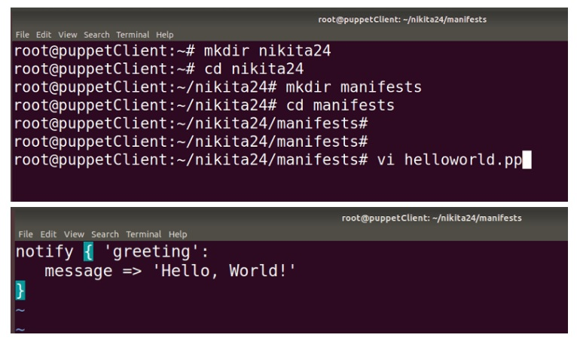

Slide 24
Applying a Manifest:
The main quality of the puppet is the ease of testing your code. In this, to work on puppet manifests, there is no need to configure complicated testing environments.

Slide 25
To apply the manifest, puppet uses apply command, which tells puppet to apply a single puppet manifest:
# puppet apply helloworld.pp
Notice: Compiled catalog for puppetclient in environment production in 0.03 seconds
Notice: Hello, World!
Notice: /Stage[main]/Main/Notify[greeting]/message:
defined 'message' as 'Hello, World!'
Notice: Applied catalog run in 0.01 seconds

Slide 26
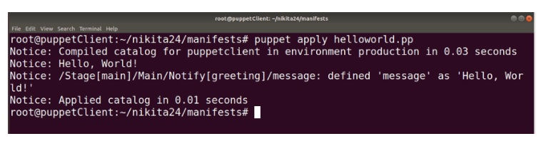

Slide 27
Here, you can see, Puppet has successfully applied the manifest. This process done by many steps:
Compile or build the Puppet catalog from the manifest.
Employes dependency and ordering information to decide the evaluation order.
Evaluates the desired resource to decide if changes should be implemented.
Create, update, or remove the resource- A message will generate in the notice.
Gives verbose output about the catalog application.

Slide 28
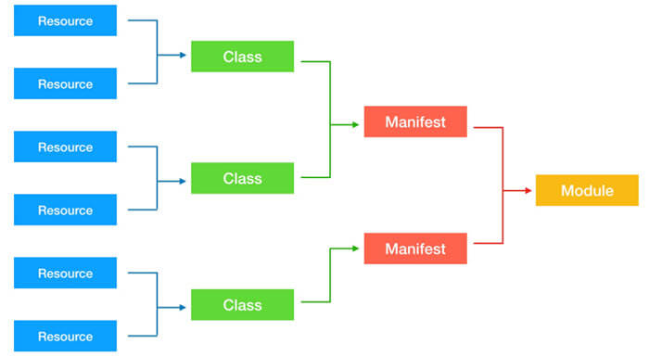
Notes:
https://www.youtube.com/watch?v=clZgb8GA6xI

